Slide 1

Analyzing Students’ Habits and Academic Performance
This analysis is made by:
Belal mohammed
Ahmed Tamer
Youssef Atwa
Youssef Khafagy

Slide 2

Questions we asked in the survey
Age and gender
How many hours do they study per day
How long they use social media or their mobile phones.
Hours for watching movies or series.
Part time job
Attendance parentage.
Sleeping hours.
Diet quality
How many hours do they exercise
Parental education level
Exam score.

Slide 3

Now how did we collect the data ?
We did a survey so students can share with us their habits and to collect the data and make sure we avoid bias we made students to sign in with their school/university accounts and do the survey and we announced that who do the survey will get a 5 marks bonus that lead a lot of students done the survey .

Slide 4

Why We Did This Analysis?
In our university, we noticed something interesting: many students were getting similar grades, even though they came from different backgrounds. This made us wonder: What habits do students have that affect their grades?
As students ourselves, we know how hard it is to balance studying, social life, and staying healthy. We often heard friends talking about staying up late to study, using social media a lot, and trying to eat well. We thought these habits might be affecting their grades.
So, we decided to find out the truth. We created a survey to ask students about their study habits, sleep, time on social media, and exercise. Our goal was to see if these habits were linked to better grades.
We wanted to understand why so many students, despite their different lives, ended up with similar scores. We gathered data from 1,000 students to find out what behaviors helped improve their performance.
In the end, our analysis isn’t just about numbers; it’s about the stories behind them. We hope our findings will help universities create better support for students, encouraging healthy habits that lead to success in school and life.
This Photo by Unknown Author is licensed under CC BY-SA-NC

Slide 5

stop
The IQ level of each student is an important factor ; however, we didn’t the ability to ask the students about their IQ level so we decided to treat them all that they all have the same IQ level

Slide 6
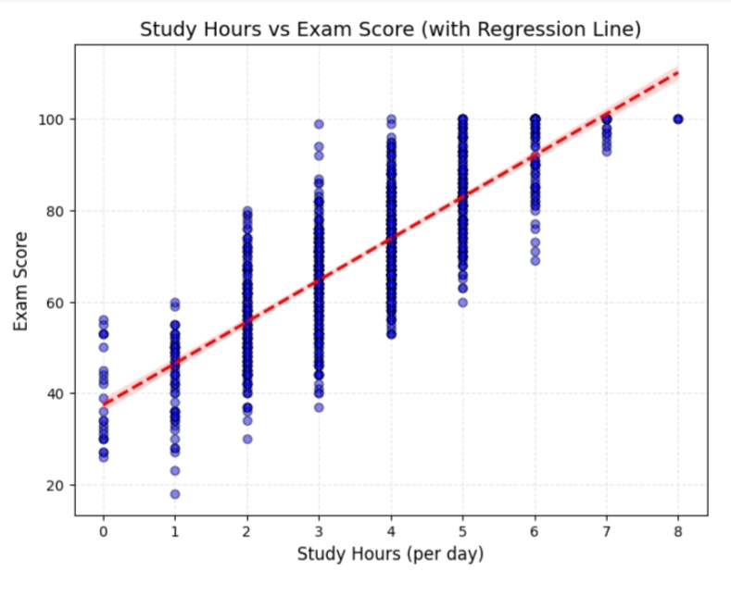
Key Hypotheses
• H1: More study hours per day are significantly associated with higher exam scores. • H2: Habits like sleep, diet, and exercise positively impact study hours. • H3: High screen time negatively impacts academic performance.

Slide 7
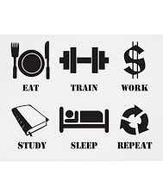
conclusion
• This project highlights how daily student
habits shape academic outcomes.
• - Encourage sleep, exercise, and healthy diets.
• - Minimize screen distractions.
• - Create study-supportive environments.
• Better habits = better performance.

Slide 8
Thank you

